Slide 2
Welcome to Orientation!
Sign in beside your name at the front table. If your name is not listed, go to the student window and ask for Lisa.
Take one of each document.
Take your ID badge lanyard. IDs will be given out during orientation
Take the schedule that has your name on it. If you do not have one see Lisa at the student window.
We will begin at 8:00 AM

Slide 4
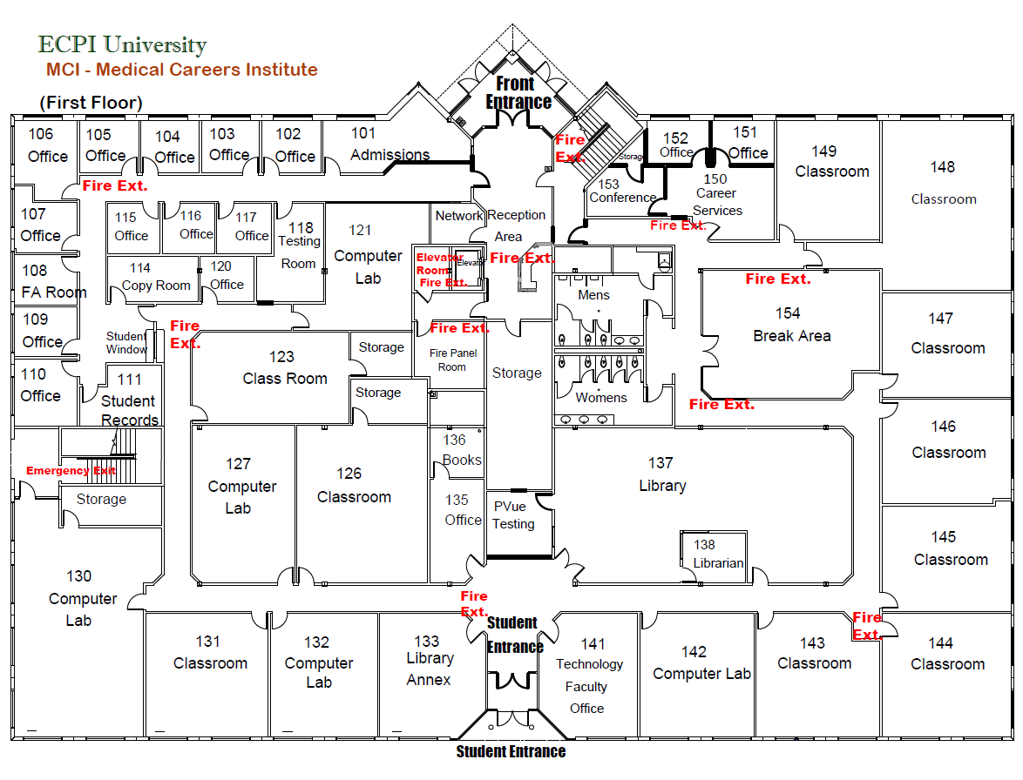

Slide 5
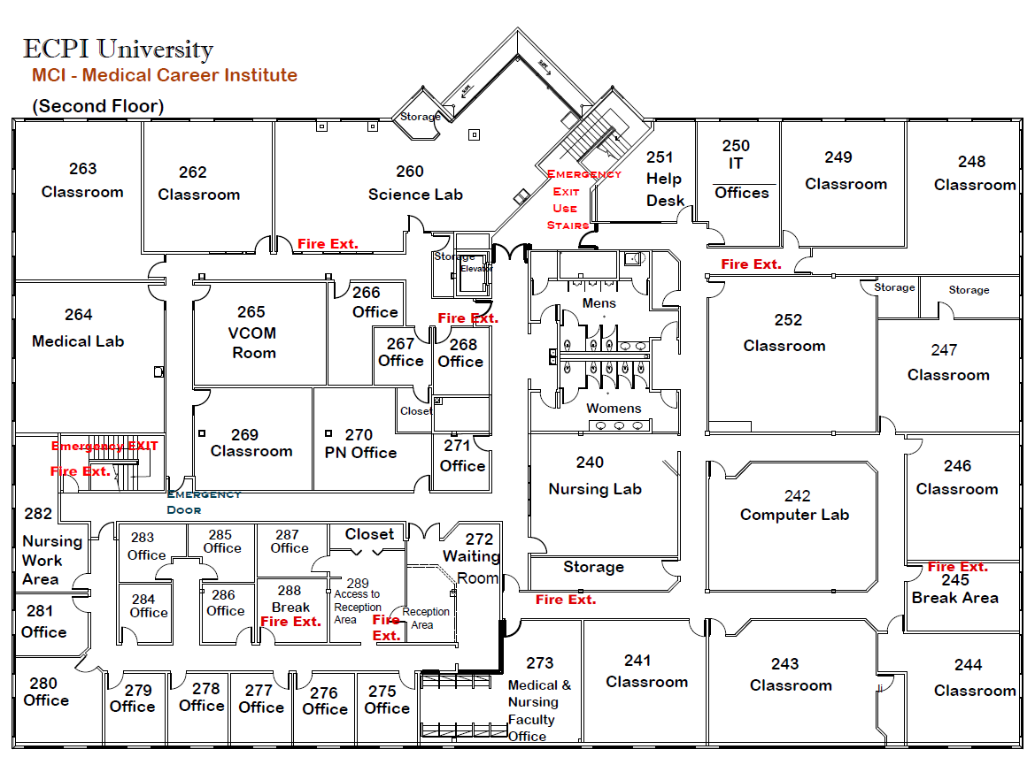

Slide 10
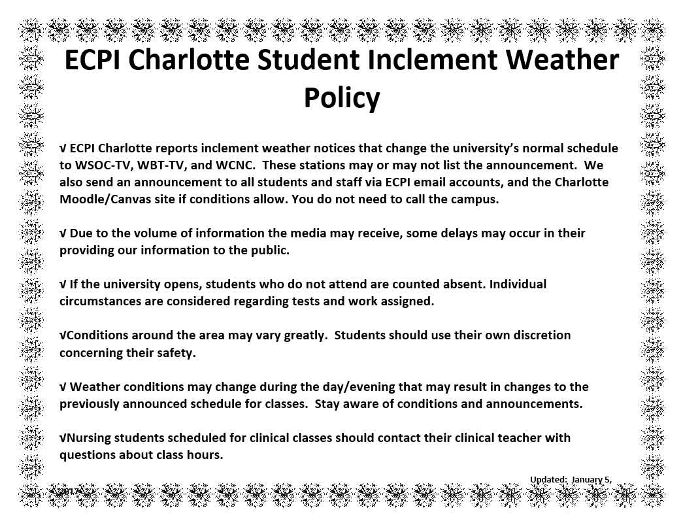

Slide 17


Slide 19
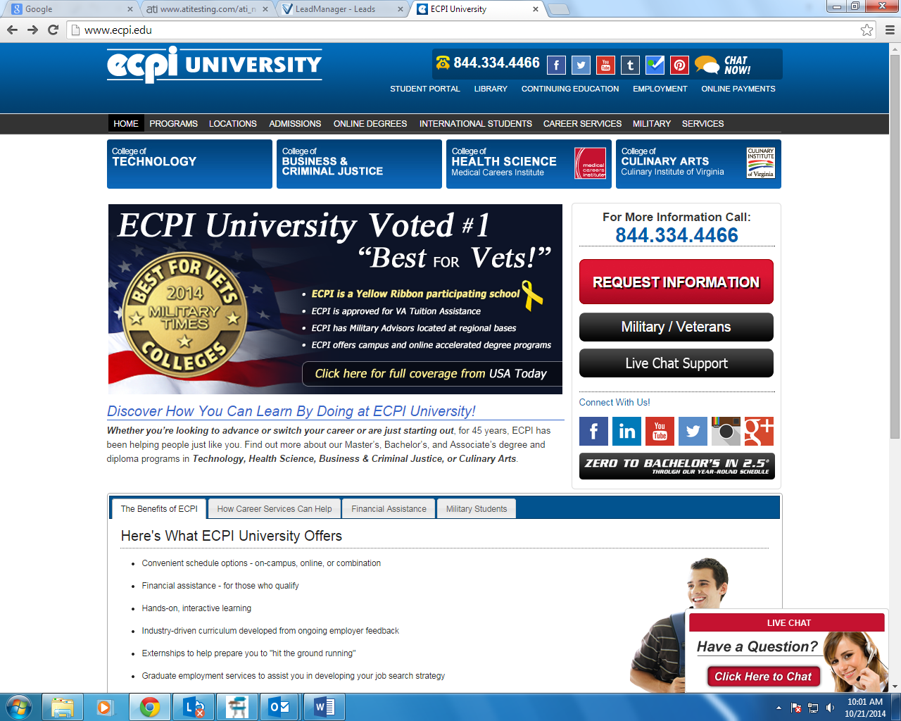
Click online payments
Directions for Electronic Payments:
Step (1): Go to ECPI University Website (http://ecpi.edu)
Step (2): Select “ONLINE PAYMENTS at the top right corner.
Continued next page …

Slide 20
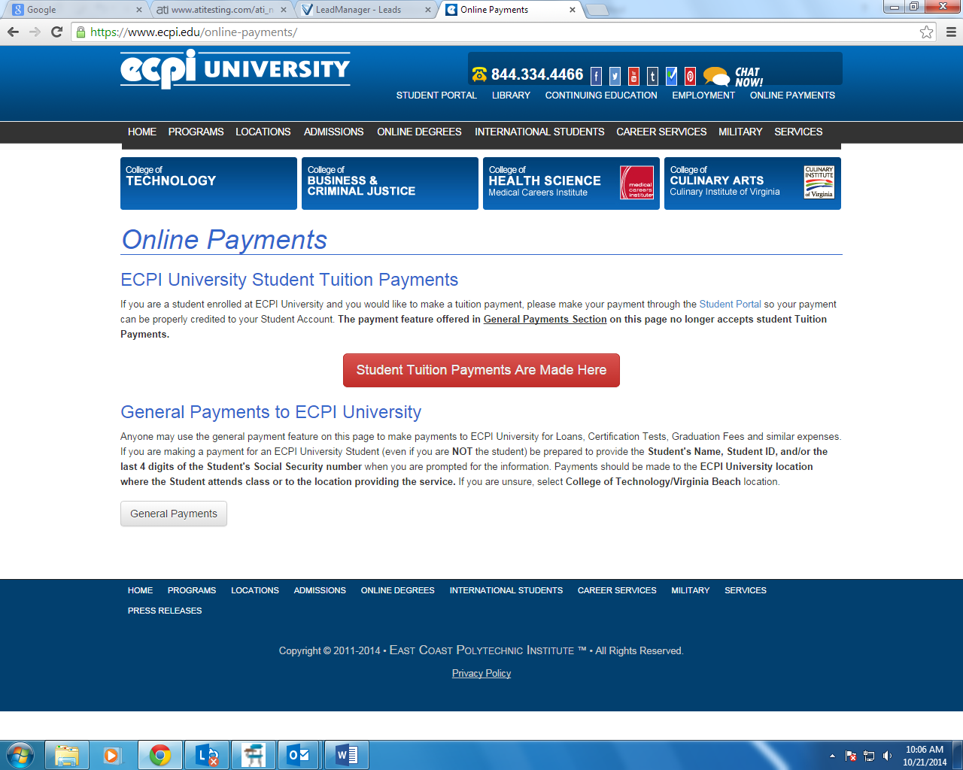
Click:
For Student Tuition Payments
Click:
For all other payments
Continued next page …

Slide 22
Continued next page …

Slide 23
Continued next page …

Slide 24
Continued next page …

Slide 26
Online Orientation - continued next page …

Slide 28
Loaner Textbook and
Electronic Device Disclosure
Form

Slide 30
Certification Exams
Certification Exams continued ............

Slide 31
Certification Exams continued ............

Slide 33
Success Factors
Tips:
  Set aside specific time each day/night for study.
  Get tutoring.
  Take lots of good notes.
  Study to learn, not just to pass tests.
  Maintain your integrity.
  References can come from teachers, staff, fellow students for jobs.
  Avoid conflicts with others.
Requirements:
  Attendance
  Pay tuition
  Behavior
  Pass courses
Integrity and Honesty
  Plagiarism
  Not following testing procedures

Slide 34
Having an effective and satisfying career plan.
Your dream.
Reaching your goals.
Effective instruction.
Acquiring skills for a rewarding career.
It’s what matters

